Slide 1
Deans power points

Slide 2
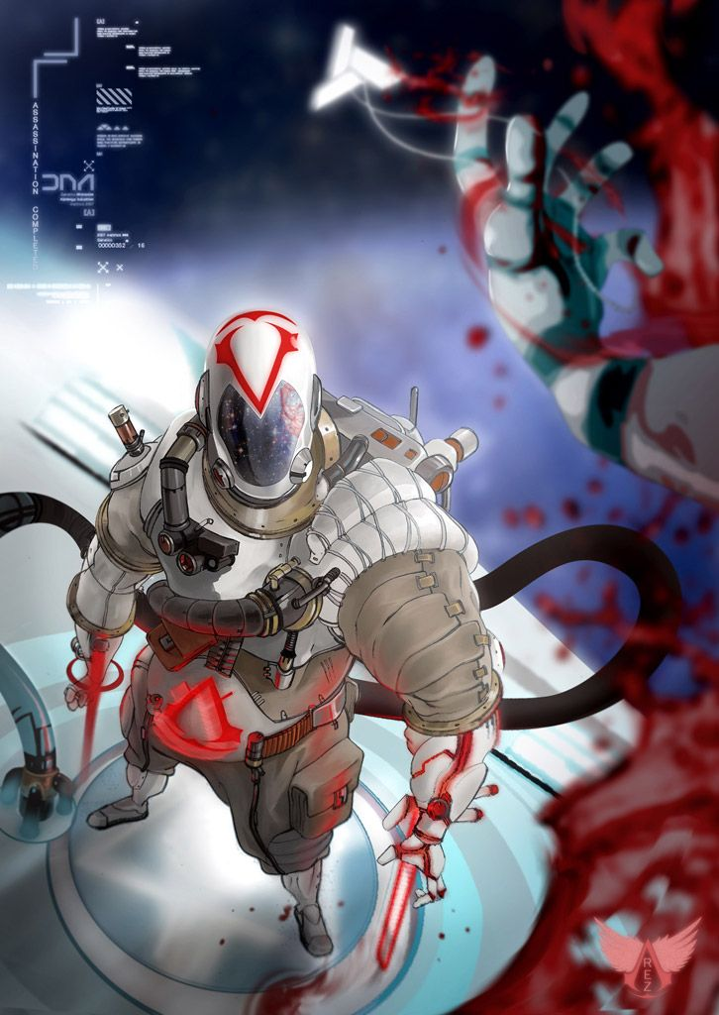
Core Pillars
Stealth
Open World
Real time combat with counters and parries
Parkour

Slide 3
Gameplay description
The overall gameplay loop would have players fly around on the "hidden jetpack" to stealth around
open space where you assassinate the space templars
variety of new and old weapons “All laser based”

